Slide 1
Deconstructing API Security
Ian Goldsmith
@apibuilder
Notes:
I’m Ian Goldsmith, I own the products for Akana, a leading providers of enterprise API solutions, with a stong focus on security. I’ve been working in security for over 25 years now, and have seen more than my share of change in that time.
I’m going to spend most of the time we have this morning discussion security concerns and solutions for APIs and how they may differ from traditional approaches to internet security.
Before I start into all that though, I’d like to take a couple of minutes to ensure that we’re all on the same page about what companies use APIs for, and why they’re so important. I’ll also touch on the (well to be honest my) definition of an API.

Slide 2
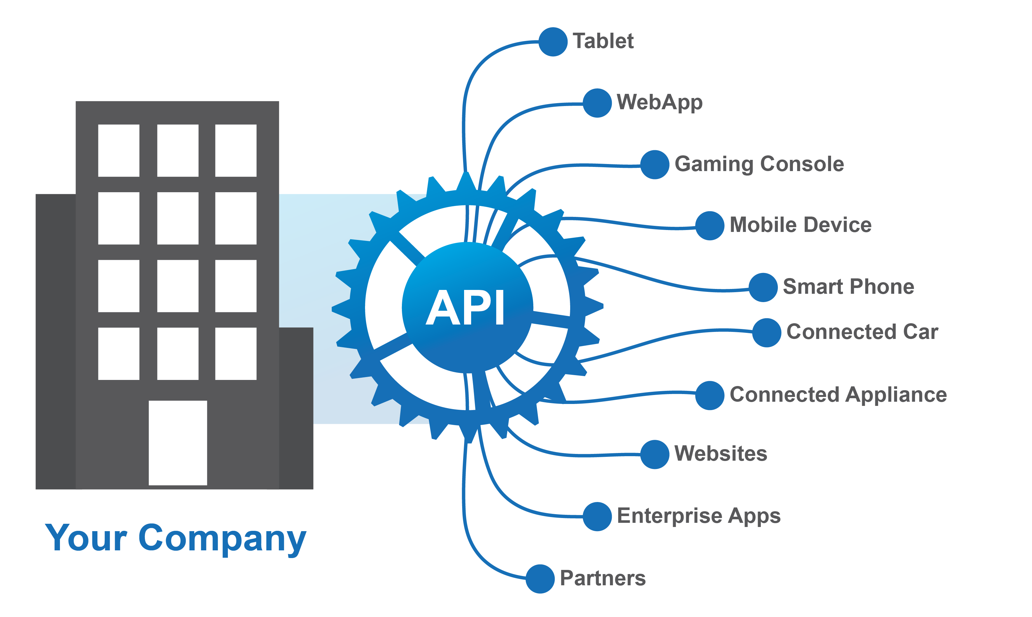
APIs Extend your Digital Ecosystems
Notes:
While APIs are not always exposed outside the enterprise (in fact the majority of the APIs out there are still inside the enterprise, these just aren’t the scenarios we all hear so much about) it’s the external use-cases that drive business value and hence excitement. It’s also the APIs that companies expose outside the enterprise that introduce the most risks, but we’ll get to that later. One of the main reasons companies are adopting APIs is to drive a multi-channel strategy.
Consumers are connected via a growing range of devices – key to reach them where they are
IoT emerging
Context as important as content

Slide 3
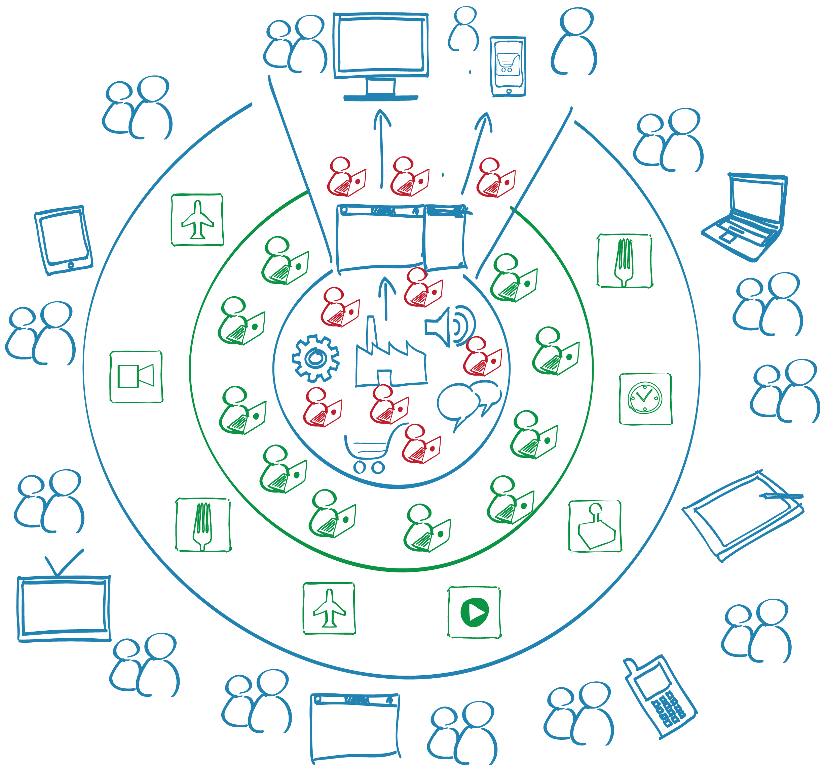
Leverage Developers & Partners Ecosystems
Tap into an extended eco-system of developers with APIs
Notes:
Innovate outside the enterprise
Small number of internal developers building a great API allow you to leverage the power of a vast community of external developers
Netflix & Twitter are the poster children

Slide 4


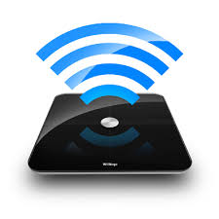

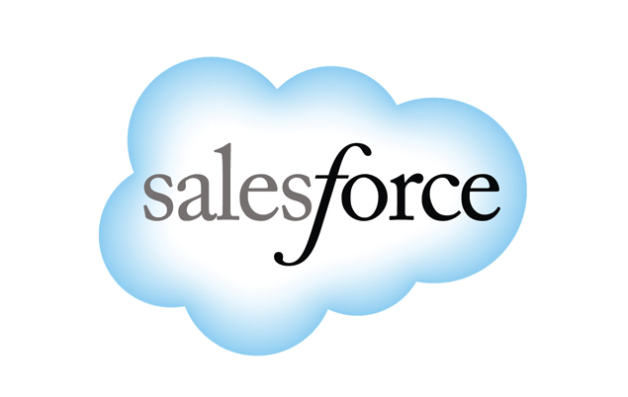
Capture new Opportunities with APIs
Drive Innovation
Increase Reach
Support New Devices
Discover New Business Models
Increase Partner Network
Notes:
So what does multi-channle and external innovation really mean for the business
It’s about new opportunities
Twitter – new ways of using the service, tweet from various sites, search twitter for content, etc
Netflix – proliferation of netflix app on a huge range of devices and internet connected TVs etc
IoT – monitor and control a huge (and incredibly rapidly growing) range of devices both in the home and in the business
Twillio – identify new ways to market
Salesforce – grow the partner network with partner driven integrations

Slide 5
API security
Notes:
Ping the audience on their security programs

Slide 6
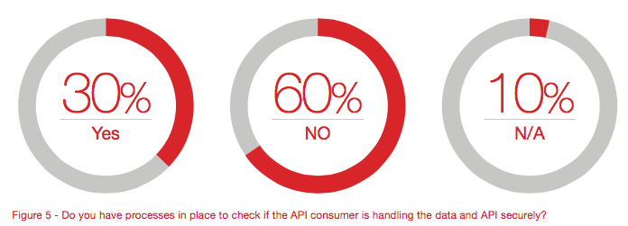
API Consumer Security?

Slide 7
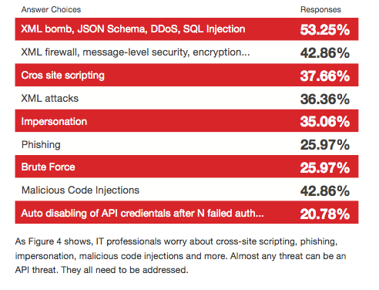
Major API Security Concerns

Slide 8
Evolution of SECURITY IN Digital CHAnnels
Notes:
Moving on to look at the security concerns around APIs

Slide 9

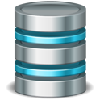
Client-Server/ Web Applications
Access locations and variability of operations were limited
No Programmatic Access
Security through network isolation
Limited Users
Notes:
In the old days of simple client server applications security was a simple matter of a firewall, and maybe a username password at the front door of the application. Once a user was inside the network, they were inside everything.

Slide 10

Web Services
The enterprise opened slightly with Web Services/SOAP
SSL/TLS, Certificate based, PKI, WS-Trust
Some B2B and Partners applications
Complex, but quite secure and flexible
Notes:
SOAP based services started life with a vision of being the way that B2B communication would all happen. Security concerns quickly scuppered that, and by the time the standards bodies properly addressed security with WS-Security, WS-Policy, WS-Federation, etc, it had become so complex that it was:
Very difficult for anyone to really use,
Borderline non-interoperable because of the range of options in configuration
Web services are in use in some B2B environments with strong security, but they certainly didn’t become the ubiquitous replacement for EDI technologies that we all hoped they might.

Slide 11
WS-Security Policy
<wsp:Policy wsu:Id="WSS11SamlWithCertificates_policy">
<wsp:ExactlyOne>
<wsp:All>
<sp:SymmetricBinding>
<wsp:Policy>
<sp:ProtectionToken>
<wsp:Policy>
<sp:X509Token sp:IncludeToken="http://docs.oasis‑open.org/ws‑sx/ws-icy/200702/IncludeToken/Never”>
<wsp:Policy>
<sp:RequireThumbprintReference/>
<sp:RequireDerivedKeys wsp:Optional="true"/>
<sp:WssX509V3Token10/>
</wsp:Policy>
</sp:X509Token>
</wsp:Policy>
</sp:ProtectionToken>
<sp:AlgorithmSuite>
<wsp:Policy>
<sp:Basic256/>
</wsp:Policy>
</sp:AlgorithmSuite>
<sp:Layout>
<wsp:Policy>
<sp:Strict/>
</wsp:Policy>
</sp:Layout>
<sp:IncludeTimestamp/>
<sp:OnlySignEntireHeadersAndBody/>
</wsp:Policy>
</sp:SymmetricBinding>
<sp:SignedSupportingTokens>
<wsp:Policy>
<sp:SamlToken sp:IncludeToken= "http://docs.oasis-open.org/ws-sx/ws-securitypolicy/200702/IncludeToken/AlwaysToRecipient">
<wsp:Policy>
<sp:WssSamlV11Token11/>
</wsp:Policy>
</sp:SamlToken>
</wsp:Policy>
</sp:SignedSupportingTokens>
<sp:EndorsingSupportingTokens>
<wsp:Policy>
<sp:X509Token sp:IncludeToken=”AlwaysToRecipient">
<wsp:Policy>
<sp:WssX509V3Token11/>
</wsp:Policy>
</sp:X509Token>
</wsp:Policy>
</sp:EndorsingSupportingTokens>
<sp:Wss11>
<wsp:Policy>
<sp:MustSupportRefKeyIdentifier/>
<sp:MustSupportRefIssuerSerial/>
<sp:MustSupportRefThumbprint/>
<sp:MustSupportRefEncryptedKey/>
</wsp:Policy>
</sp:Wss11>
</wsp:All>
</wsp:ExactlyOne>
</wsp:Policy>
Notes:
This is the just the policy, not even the definition document. Trivial huh?

Slide 12


And then came APIs
Disrupting how and where information is accessed
Mobile and Social Apps don’t’ understand PKI, WS-Security, etc.
Focus on human readability, developer adoption
Notes:
Complexity of additional access mechanisms to data and functions that had tradition remained locked inside the enterprise.
No easy way to handle SOAP and the complexities of WS-Security from mobile devices and 3rd party apps.
APIs are often part of Web Applications – SPWA, and are increasingly baing subjected to attacks listed under the OWASP (Open Web Application Security Project
) Top Ten.
Some aspects of Web Application design has had to change to enable APIs to be part of the application, specifically adding things like CORS.
Techniques to prevent things like XSS and CSRF can prevent a valid consumer from accessing an API, and so there are mitigation techniques required to keep things working properly.

Slide 13
OWASP Top Ten
A1 – Injection
A2 – Broken authentication and session management
A3 – Cross-site scripting (XSS)
A4 – Insecure direct object references
A5 – Security misconfiguration
A6 – Sensitive data exposure
A7 – Missing function-level access control
A8 – Cross-site request forgery (CSRF)
A9 – Using components with known vulnerabilitites
A10 – Unvalidated redirects and forwards

Slide 14
PCI Compliance
APIs are now part of e-commerce
Card payments pass through API
The infrastructure underlying the API?
Notes:
What is PCI? Does not apply to products.

Slide 15
Securing APIS
Notes:
Ok, intro over. Let’s move into the meat.

Slide 16
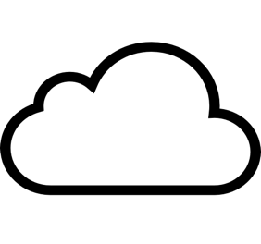

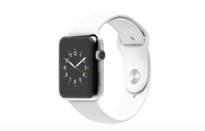


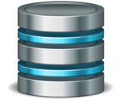


Securing APIs
5
Content Filtering
6
Rate Limiting
1
Authentication & Authorization
3
Message Security
2
App Key Validation/
Licensing
4
Threat Protection
Developers
Notes:
We’re going to cover these 6 basics of securing APIs.

Slide 17










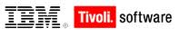
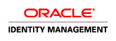


Authentication/Authorization/SSO
Control and restrict access to your APIs
Make it easy yet secure
Notes:
Is SAML still relevant for APIs? My opinion, not really, possibly in some vendor (Microsoft) specific environments.
The basic idea in most of these scenarios is that the user/application communicates with an identity provider to retrieve one or more tokens (an identity assertion - credential, and an attribute or authorization assertion). It then passes these tokens to the API that uses them to identify the end user and determine if that user is allowed to do anything. In a well-designed system these same tokens can be used for accessing multiple APIs or services.

Slide 18


Understanding OAuth
OAuth lets a person delegate constrained access from one app to another
Client App
Resource Owner
Resource Server
User
Notes:
Examples, allowing an application to post your facebook timeline.

Slide 19
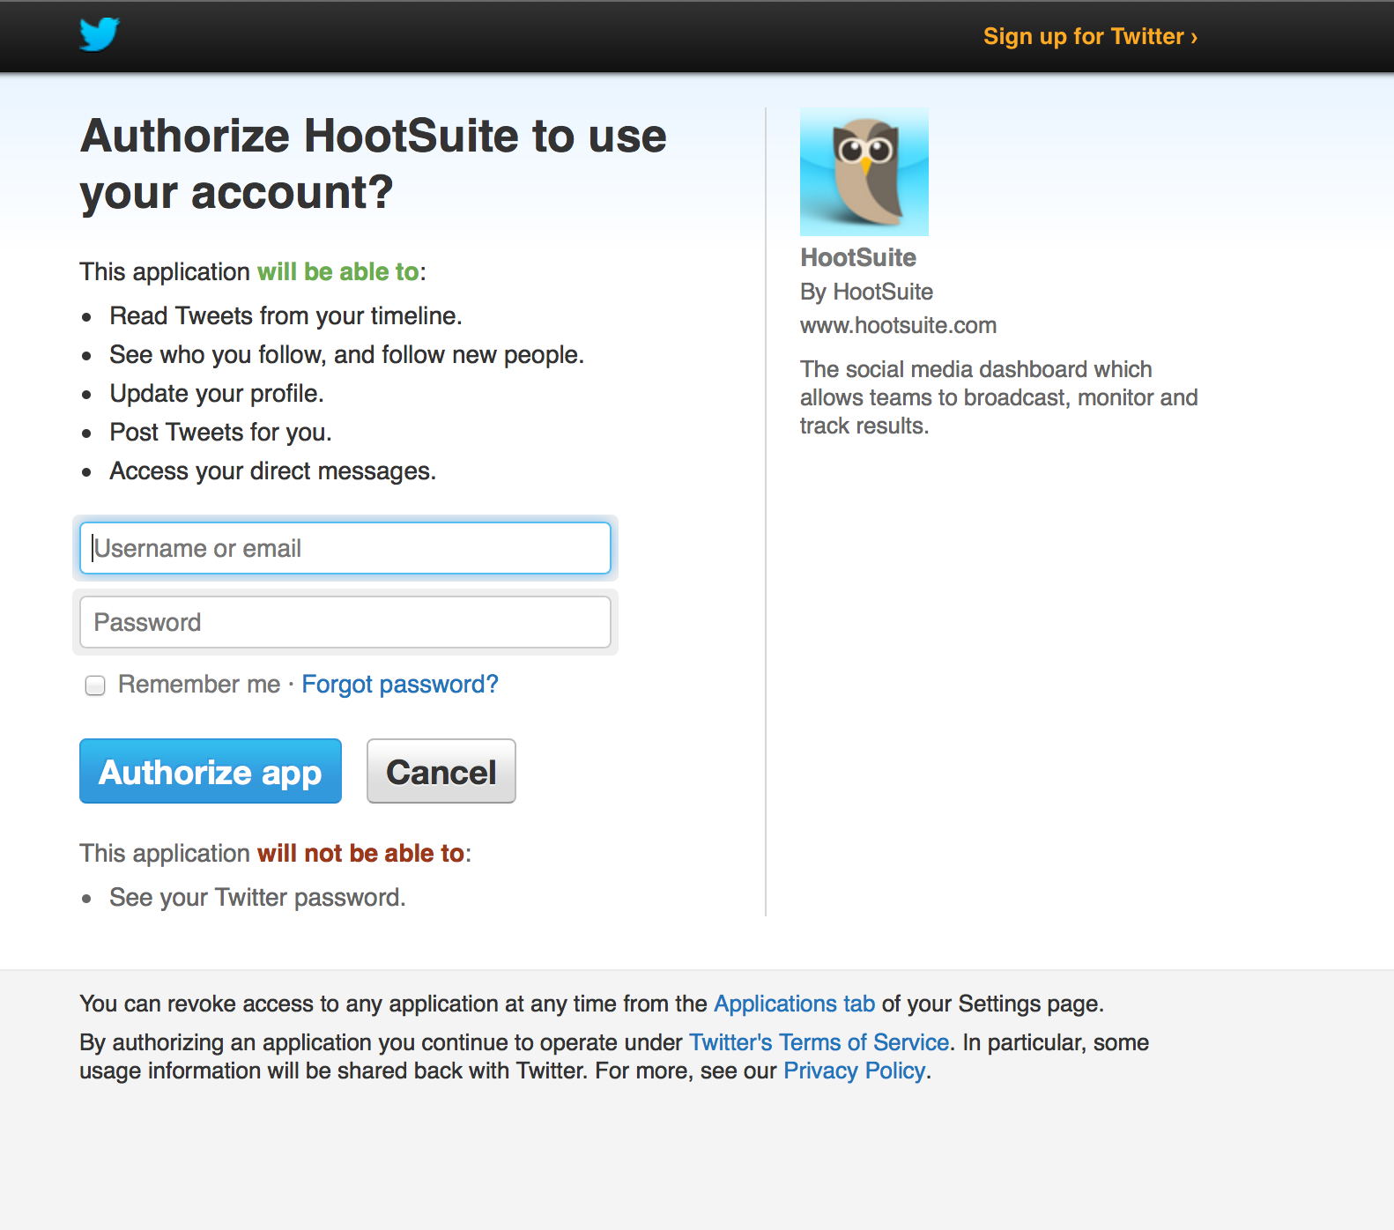
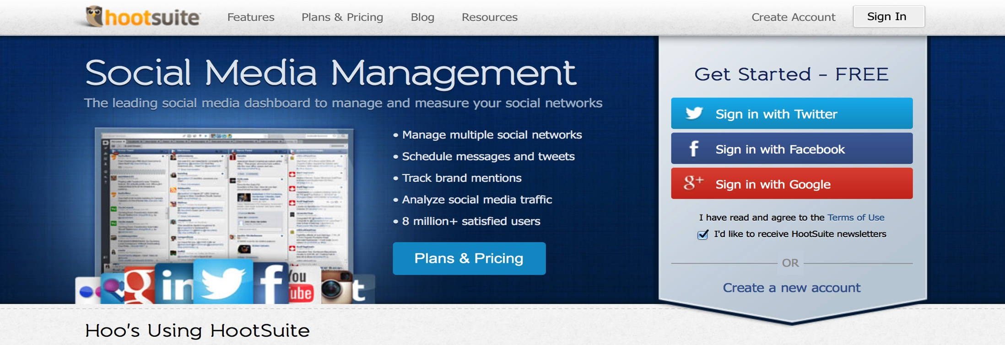
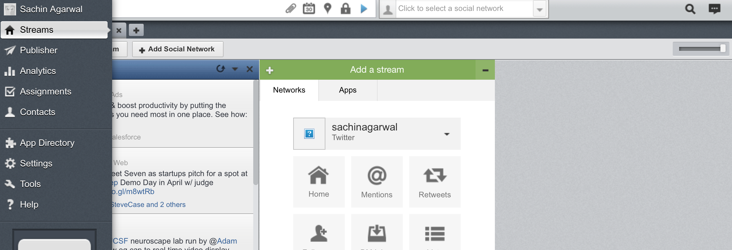
OAuth Flow

Slide 20
OAuth – You need
OAuth has become complex
OAuth Clients
Provisioning
Approval Flow
OAuth Server
Identity Integration
Token Validation
Token Issue/refresh
Token Mediation (SAML, LDAP etc)
QoS, Monitoring
Policy Management
API Proxying
Reporting
Analytics

Slide 21
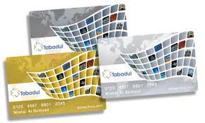


Licensing
Package your APIs in different ways
Use API keys to restrict what the App can access
The licenses control:
OAuth Authorization Scopes
Document visibility
Quota policies
Notes:
Design-time and runtime.
Manufacturing company single API example

Slide 22




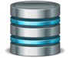


Message and Parameter Security
HTTP Parameter
http://apis.foo.com/resources/sample/foo?app_id=myid&app_key=mykey
Protect API Keys with HMAC – Hash-based Message Authentication Code
Message Security
Implement HTTPS
JWS/JWE, XML Encryption & Signature

Slide 23

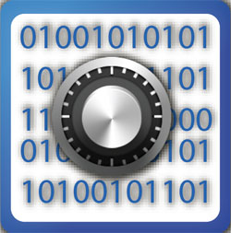
Threat Protection
Denial of Service
Injection Attacks
Detect and prevent SQL, JavaScript or XPath/XQuery injection attacks
Cross Site Scripting
Network address and range blacklists/whitelists
HTTP Parameter Stuffing

Slide 24

Content Threats
Provide a content firewall, protecting against malicious content
Validate message content including message headers, form and query parameters, XML and JSON data structures.
^{Policies for XML and JSON DoS}
Protection against viruses in attachments and other binary content via ICAP integration with leading anti-virus engines
Notes:
ICAP for AV

Slide 25
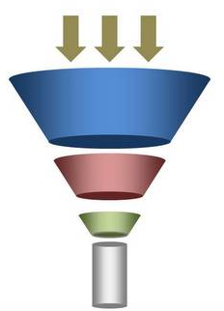
Quota Management/Rate Limiting
Restrict the number of calls an App can make
Apply controls based on context, affinity, segmentation etc.
Notes:
Done on a per-consumer basis

Slide 26
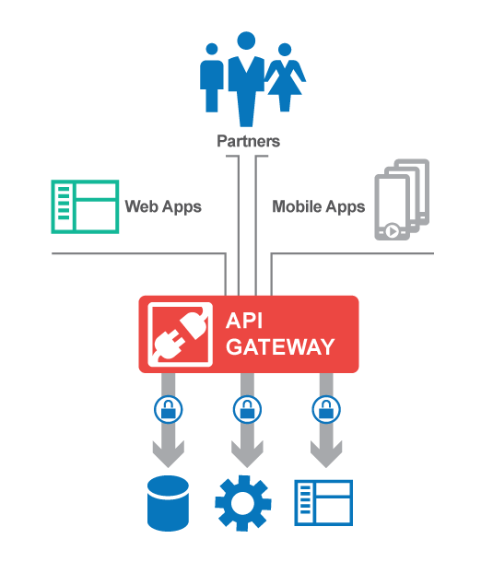











API Gateway
Gateway
Security
Authentication
Protection
IAM Integration
Encryption
Mediation
Quality of Service
Paging/Caching
Orchestration
Scripting
Notes:
This is how you deliver all the above security requirements

Slide 27
Managing and Automating Security

Slide 28
Credit : Peter Cheslock

Slide 29

Govern Manage your Development/Deployment Process
API Initiatives need to integrated with your DevOps
Define and track multiple API and versions and the dependencies on those versions throughout the process.
Integrated with your development tools – IDE, Github, Chef, Puppet
Integrated with your deployment Tools
APIs
Lifecycle

Slide 30
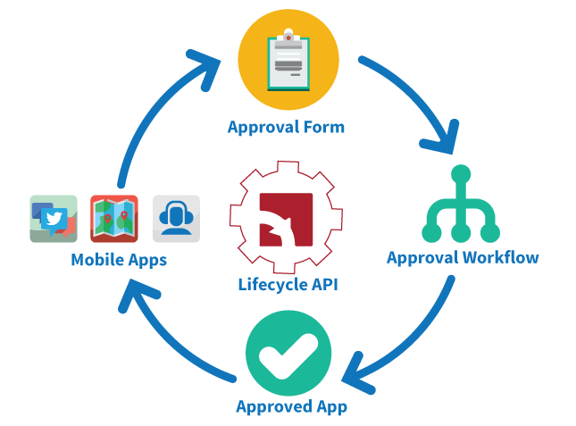
Automated Governance of Apps
User and App onboarding
Configurable forms to gather user/app info, collect agreements, etc.
Configurable role-based notifications and approvals
Mobile app based API SDLC approvals
Deliver approval requests to stakeholders on their preferred platform
DevOps automation

Slide 31



API Resources and API University
Resource Center
http://resource.akana.com/
Follow us on:
www.facebook.com/soasoftware
www.linkedin.com/company/soasoftware
@soasoftwareinc

